Slide 1


Neural Network and Deep Learning
By
Smruti Das

Slide 2
Task Outline:
The Game
Collecting data
Understanding how a NN will play the game
The objective of the game:
Steer and apply thrust to the lander.
Avoid hitting the outside edge or the ground.
Safely put the lander on the target to proceed.
Data Inputs:
X Distance to Target
Y Distance to Target
Data Outputs:
New Velocity Y
New Velocity X
Details

Slide 3
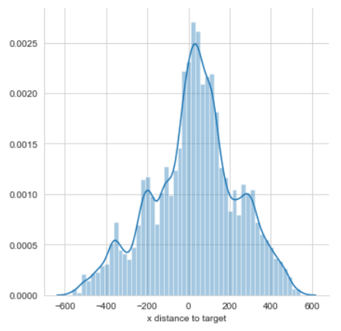
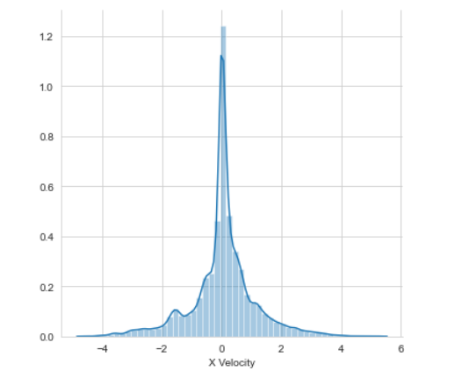
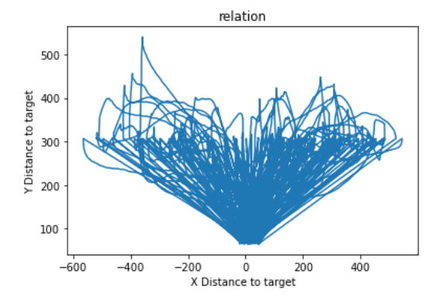
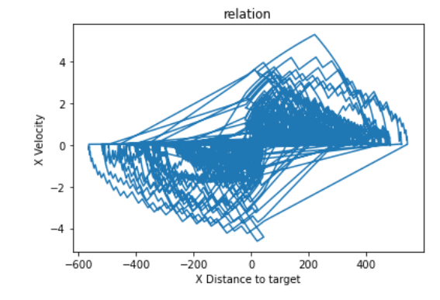
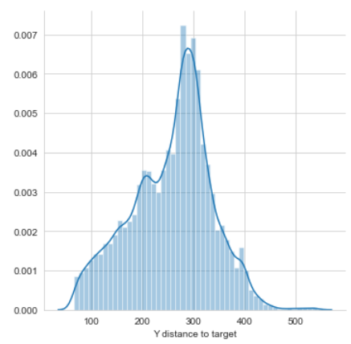
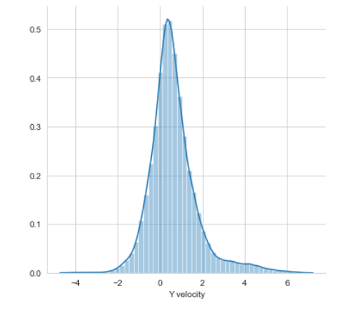
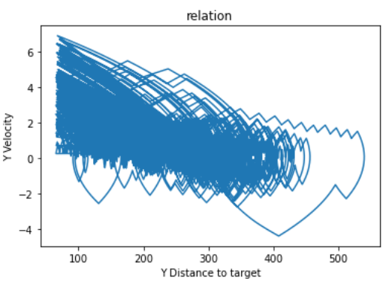
Input & Output Plots
Distribution Plot for Inputs
Distribution Plot for Outputs
Relation Between Inputs
Relation Between X Distance to Target and X Velocity
Relation Between Y Distance to Target and Y Velocity
Both Input and Output have nearly Normal Distribution

Slide 4
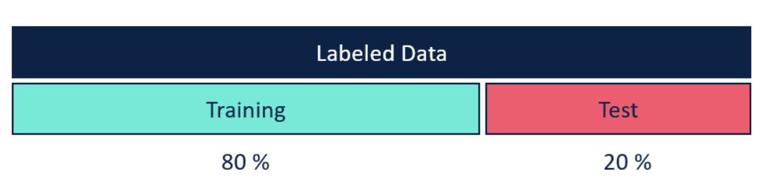
Data Partition
Data is partitioned into Train and Validation set using Sklearn’s train_test_split in ModelSelection Package
In this Data is randomly partitioned into Train and Validation set
Train Data set is 80%
Validation Data Set is 20%

Slide 5
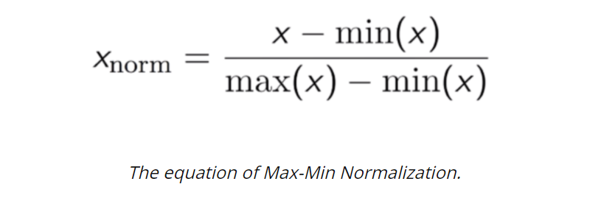
Data Processing
Data is normalized using Min Max Scaler from Sklearn
This will squeeze all the data within 0 and 1
Data Cleaning
Removed any rows that have zeros in output
Checked for if any negative values in y distance to target.
all duplicate values for outputs are removed , even if inputs are different.

Slide 6
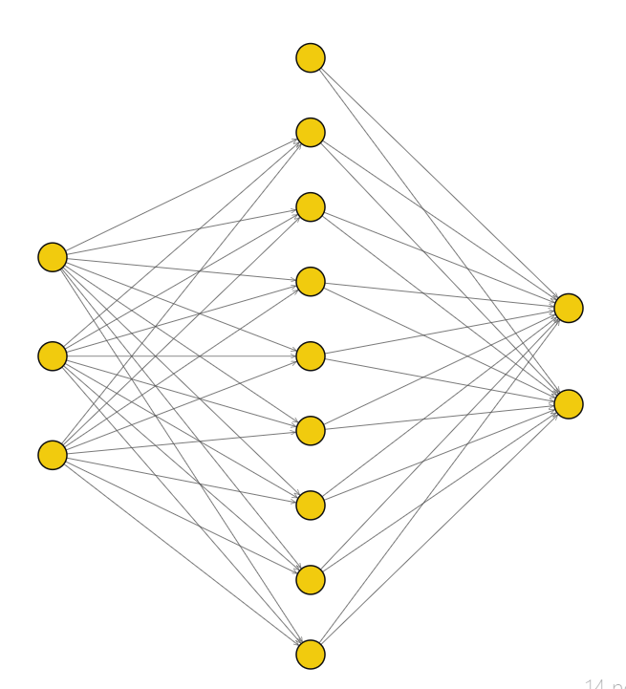
Architecture Design
A Multi Layer Perceptron is used to build this model.
This Model has 2 Inputs and 2 Outputs
It has one hidden layer with 8 Neurons
I have tested the number of hidden neurons keeping rest all hyperparmeters constant and got best results in 8 neurons
Bias
Inputs
Outputs
Bias
Hidden Layer

Slide 7
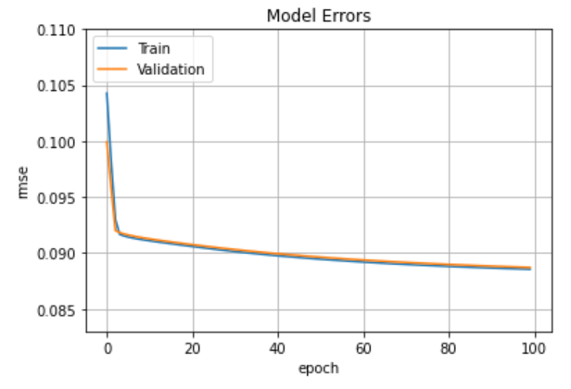
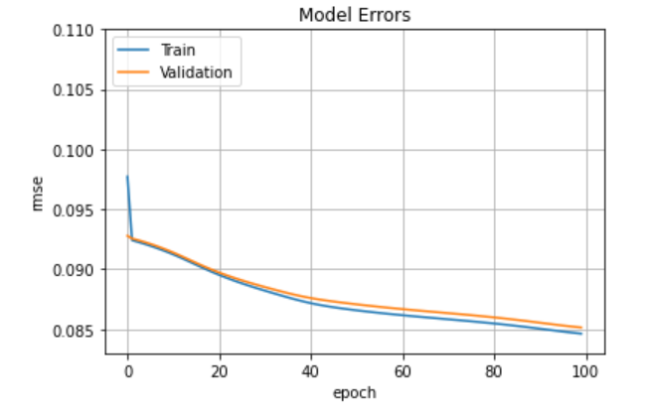
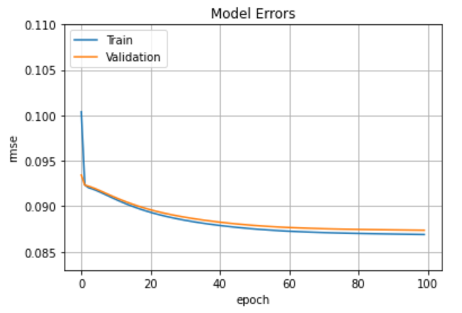
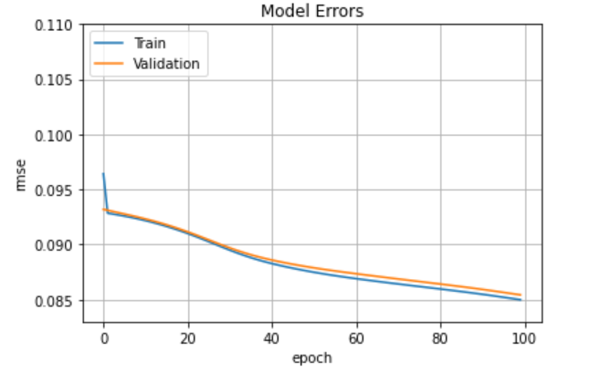
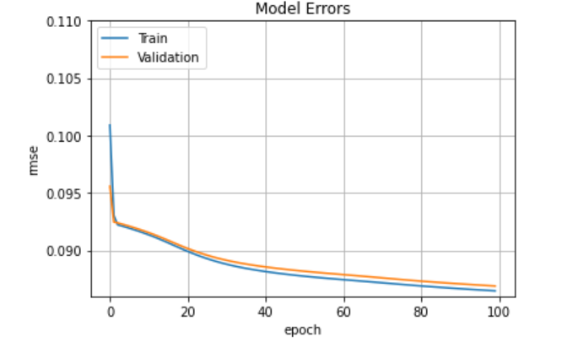
Hidden Layer Neurons
Hidden Layer Neurons = 2
Learning rate=0.3
epochs =100
lambda = 0.6
Momentum Rate = 0.2
Initial weights same for all cases
Hidden Layer Neurons = 8
Observations:
For this case, we can clearly see that there is not much impact of number of neurons on error. Our Neural Network adjusts the weights and is able to learn the relation with any number of neurons. However, the error slightly decreases with increase in number of neuron
We can see that the error remains nearly same for 8 and 16 neurons.
As the error is best at 8 neuron, I have chosen 8 neurons in my hidden layers
Hidden Layer Neurons = 4
Hidden Layer Neurons = 16
Hidden Layer Neurons = 6
# Neurons | RMSE
2 | 0.0887
4 | 0.0874
6 | 0.0868
8 | 0.0849
16 | 0.085

Slide 8
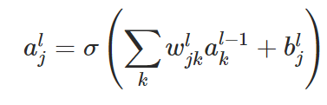
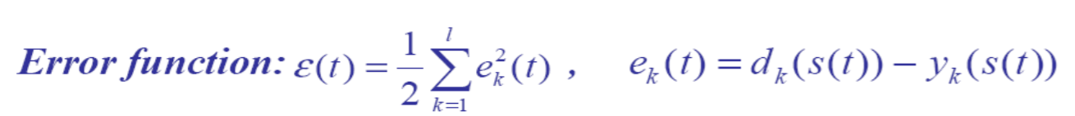
Feed Forward
Feed forward is the process of getting the predicted outputs based on the inputs, weights and bias.
Activation function is used in hidden and output layer.
I have used sigmoid in both the layers
Error Calculation
we calculate the MSE error using below formula
While calculating the gradients, we take derivative of error which is
Error = Actual Output – Predicted Output

Slide 9
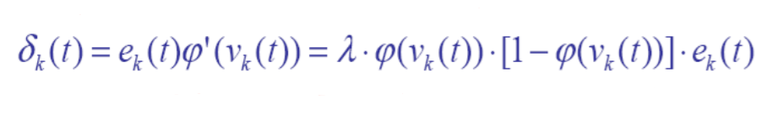
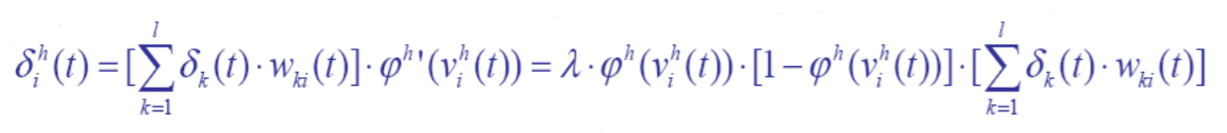
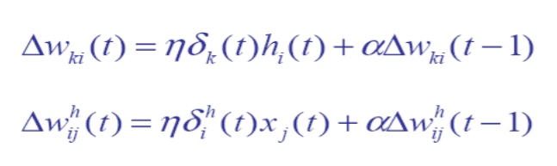
Back Propagation
Based on the error we try to adjust the weights and bias, in order to minimize the error by calculating the local Gradients in both Output and Hidden layer
Using the Gradients we calculate the change in weights using below formula
We use momentum in order to add previous run change of weight by factor of momentum rate which can be tuned.

Slide 10

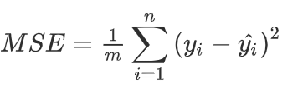
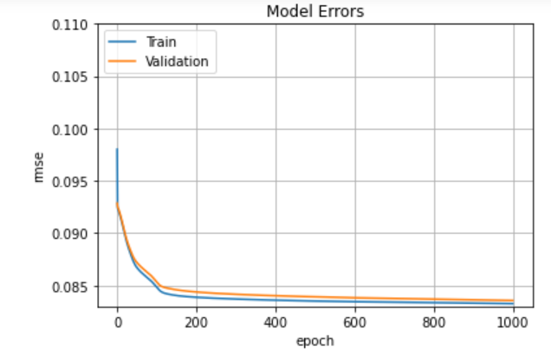
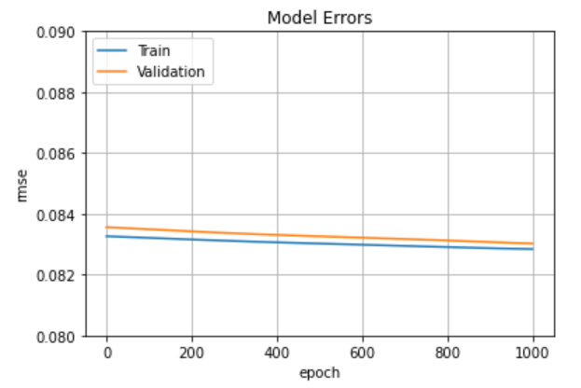
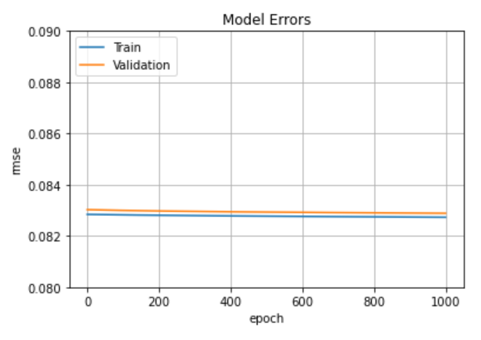
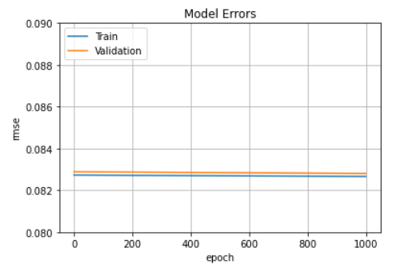
RMSE Error
Root Mean Squared Error is used to determine how good the model is.
epochs = 1 to 1000
epochs =1000 to 2000
I have trained the model in several Batches. Each batch is in continuation of the previous
My Final Training RMSE is 0.0857
Validation RMSE is 0.08265
epochs =2000 to 3000
epochs =3000 to 4000
epochs =4000 to 5000

Slide 11
Stopping Criteria
We need to use a stopping criteria in order to stop training once the model starts overfitting
During training, the model is evaluated on a validation dataset after each epoch. If the performance of the model on the validation dataset starts to degrade (e.g. loss begins to increase or accuracy begins to decrease), then the training process is stopped.
If the validation error in current epoch is more than previous epoch by 0.001 then we start counting it till we reach a Patience level(5), then training process will stop
If The training loss or validation loss is equal to 0 i.e out model has completely learnt . We stop the training. This stage almost never comes however its good to have the condition added
Hyperparameter Tuning
Adjusting the Hyperparameters like learning rate, number of hidden neurons and momentum rate
Need for hyper-parameter tuning
To prevent vanishing/exploding gradient problem
We can get stuck in local Minima
To find the right balance between bias and variance

Slide 12
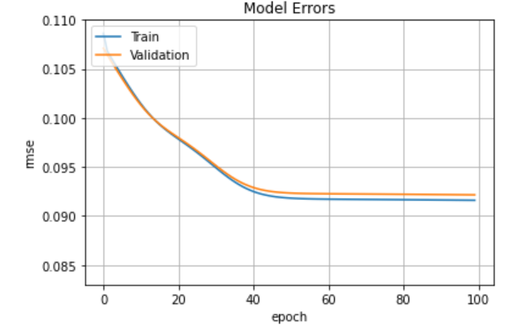
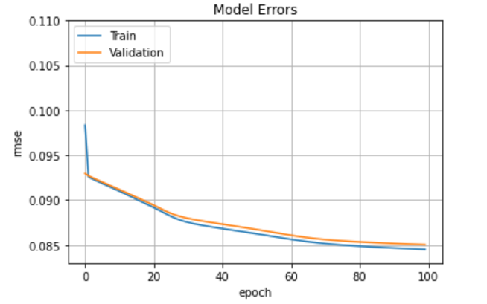
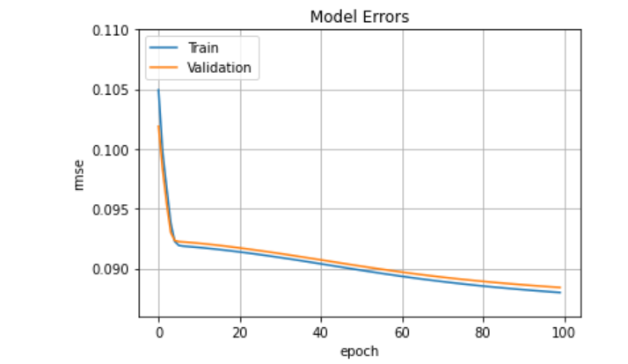
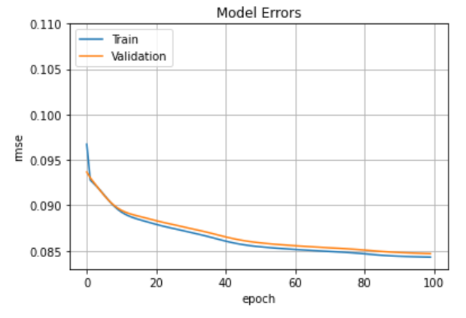
Hyperparameter – Learning Rate
Learning_rate=0.01
Hidden Layer Neurons = 8
epochs =100
lambda = 0.6
Momentum Rate = 0.2
Initial weights same for all cases
Learning_rate=0.5
Observations:
For this case, higher the learning rate better is the plot. It keeps on decreasing as we increase learning rate.
For learning rate=0.01, the error has stabilised at 40 epoch with 0.092 which is higher than other errors.
There is no much significant difference between 0.5 and 0.8
we should not use too low learning rate – optimization will take a lot of time.
We should not use too high learning rate -training may not converge. Weight changes can be so big that the optimizer overshoots the minimum and makes the loss worse.
As any learning rate between 0.3 to 0.5 seems to be a wise choice, I have chosen 0.3 , as in Matlab 0.3 had better results (in Later Slide)
Reference link: https://towardsdatascience.com/estimating-optimal-learning-rate-for-a-deep-neural-network-ce32f2556ce0
Learning_rate=0.1
Learning_rate=0.8
Learning_rate=0.3

Slide 13
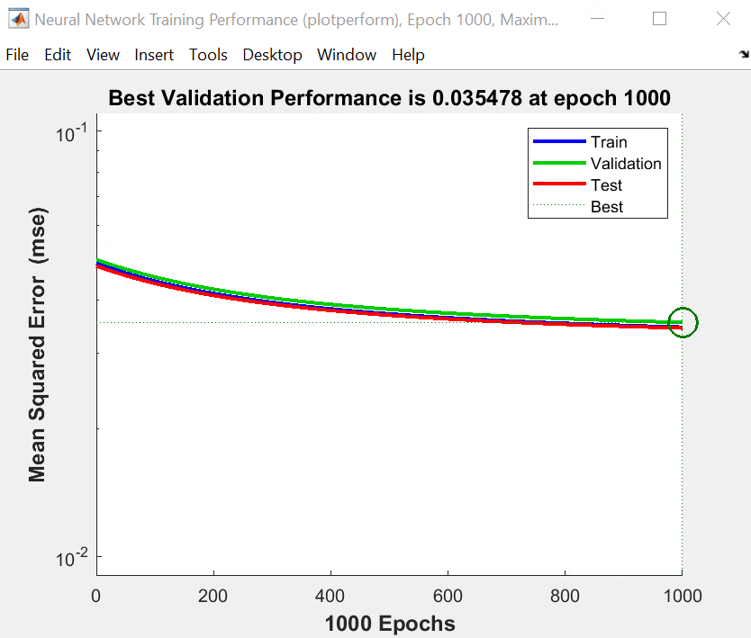
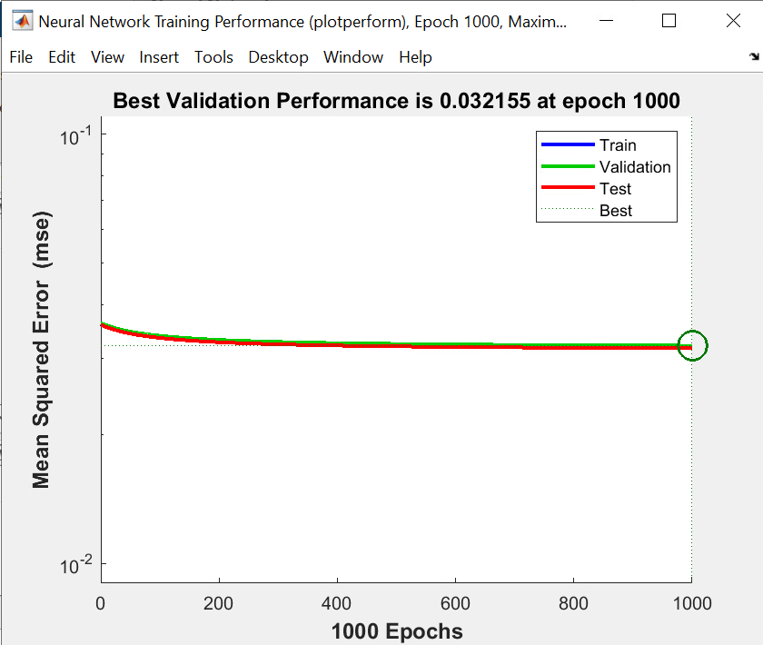
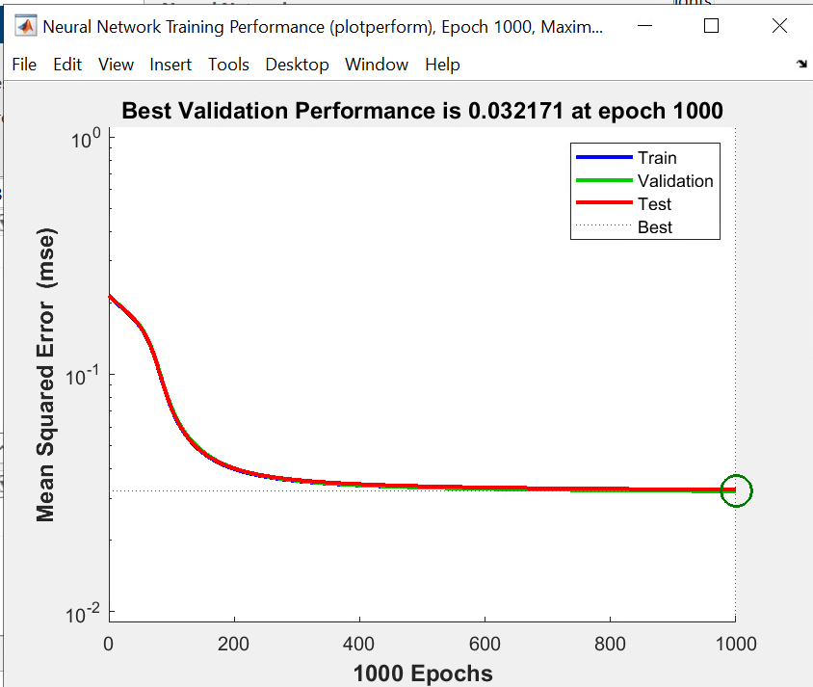
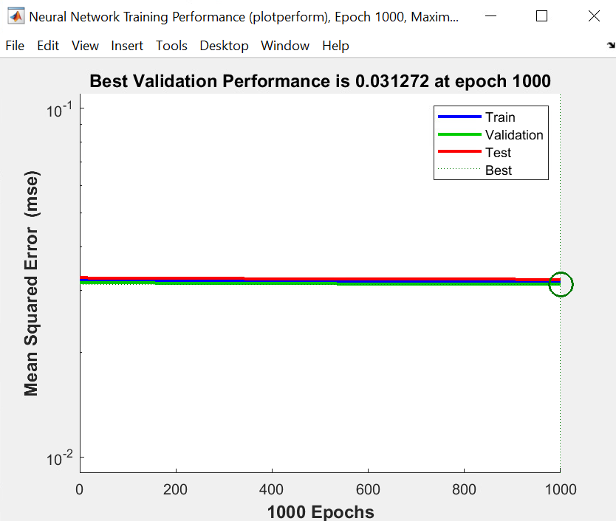
Hyperparameter – Learning Rate
Using Matlab
Learning Rate: 0.1
Learning Rate: 0.5
Have used Learning Rate 0.3
Learning Rate: 0.3
Learning Rate: 0.7

Slide 14
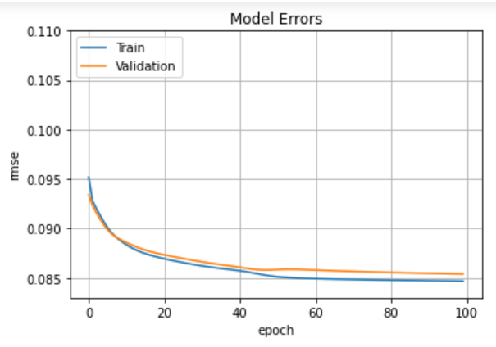
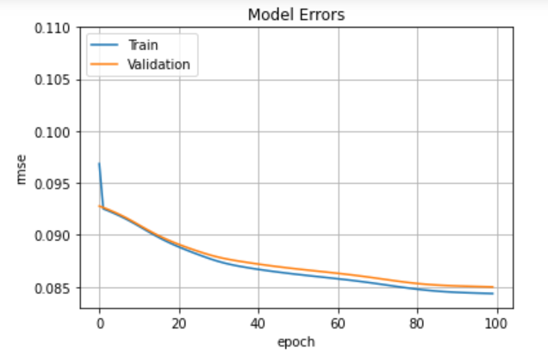
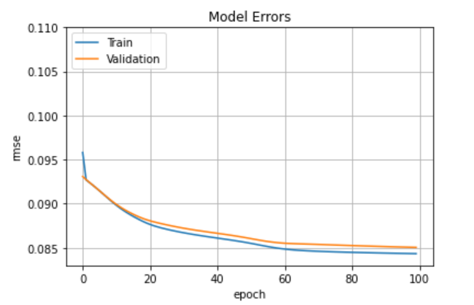
Hyperparameter – Momentum Rate
Learning_rate=0.3
Hidden Layer Neurons = 8
epochs =100
lambda = 0.6
Initial weights same for all cases
Momentum Rate = 0.6
Momentum Rate = 0.2
Observations:
Clearly momentum rata has no impact on the learning rate, except the gradient descent is better for smaller value of momentum rate
As per the below material lower value of momentum gives better result. Hence have used 0.2
Reference link: https://towardsdatascience.com/stochastic-gradient-descent-with-momentum-a84097641a5d
Momentum Rate = 0.8
Momentum Rate = 0.4

Slide 15
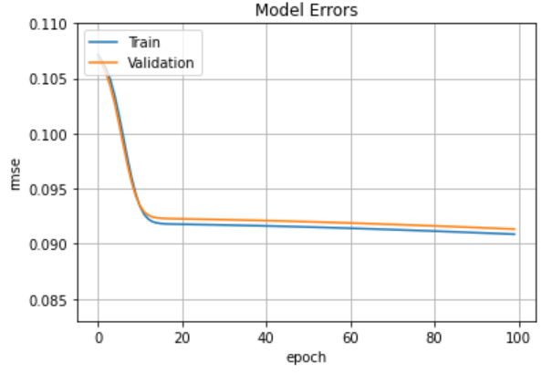
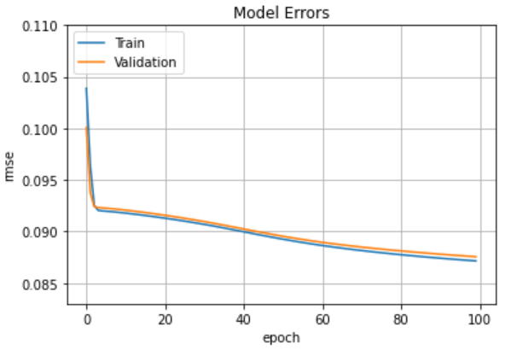
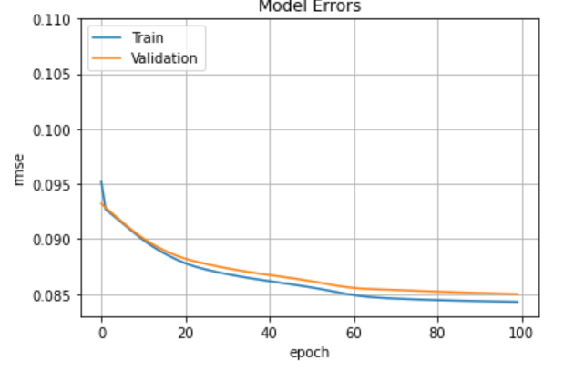
Lambda value
lambda = 0.6
lambda = 0.2
Learning_rate=0.3
Hidden Layer Neurons = 8
Momentum Rate = 0.2
epochs =100
Initial weights same for all cases
Observations:
For this case, we can clearly see that there is not much impact of number of neurons on error. However, the error slightly decreases with increase in value of lambda
As we should select not too high or too low value of lambda , I am using 0.6
lambda = 0.4
lambda = 0.8

Slide 16
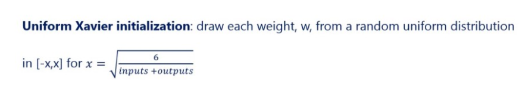
Initialise the Weights
When we have a sigmoid activation function, it is better to use Xavier Glorot initialization of weights.
[-x,x] in range [sqrt(6/2+2)]
Initial weights in range [1-,1]
Initial weights in range [-1.22,1.22]
The error was lower when we started with initial weights as per Xavier Glorot initialization of weights.
https://medium.com/@sakeshpusuluri123/activation-functions-and-weight-initialization-in-deep-learning-ebc326e62a5c

Slide 17
Integration with the Game
Steps:
1. Load the saved weights from the Neural Network training.
Have saved the weights after training the model. We will use these weights in forward propagation to make prediction. We will import the saved min max values for the features and target as well
2. Convert the input to numpy array
As the input is in string format we need to convert it to numpy array to feed to forward propagation
3. Normalize the Data
we need to normalize the inputs as done while training . Using the Min/ Max values we will get the normalized values for the inputs
4. Predict the output (forward propagation)
Using the weights , make the prediction as done while training the network
5. De-normalize the output
As the game would need the de-normalized data to move the aircraft accordingly, we will de normalize using below formula
De-norm = X * (Max – Min) + Min
6. Return the value

Slide 18
Conclusion
Neural networks are suitable for predicting regression values ,because of learning only from examples, without any need to add additional information that can bring more confusion than prediction effect. Neural networks can generalize and are resistant to noise.
On the other hand, it is generally not possible to determine exactly what a neural network learned, and it is also hard to estimate possible prediction error.
However, neural networks were often successfully used for Prediction.
This Assignment was a great learning experience for me, It helped me to gain in depth knowledge of how simple Neural Network works.
My Final Training RMSE is 0.08257

Slide 19
References
Professor Hani Hagras’ Notes, Topic 4-5,
Ian Goodfellow ,Yoshua Bengio & Aaron Courville, Deep Learning - Adaptive Computation and Machine Learning, Chapter 6, 2015
Michael Nielsen, Neural Networks and Deep Learning,2019
James Joy Blog, How to build your own Neural Network from scratch in Python, towardsdatascience.com
Shashank Ramesh Blog, A guide to an efficient way to build neural network architectures- Part I: Hyper-parameter selection and tuning for Dense Networks using Hyperas on Fashion, towardsdatascience.com,2018

